Slide 1
CLASS – XII
SUBJECT- PHYSICS
CHAPTER- MOVING CHARGES AND MAGNETISM

Slide 2
MAGNETIC EFFECT OF CURRENT - I
Magnetic Effect of Current – Oersted’s Experiment
Ampere’s Swimming Rule
Maxwell’s Cork Screw Rule
Right Hand Thumb Rule
Biot – Savart’s Law
Magnetic Field due to Infinitely Long Straight Current – carrying Conductor
Magnetic Field due to a Circular Loop carrying current
Magnetic Field due to a Solenoid

Slide 3
Magnetic Effect of Current:
An electric current (i.e. flow of electric charge) produces magnetic effect in the space around the conductor called strength of Magnetic field or simply Magnetic field.
Oersted’s Experiment:
N
When current was allowed to flow through a wire placed parallel to the axis of a magnetic needle kept directly below the wire, the needle was found to deflect from its normal position.
E
I
K
I
When current was reversed through the wire, the needle was found to deflect in the opposite direction to the earlier case.
N
E
K

Slide 4
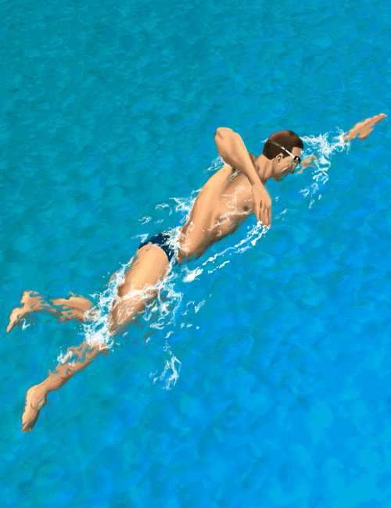

Rules to determine the direction of magnetic field:
W
N
Ampere’s Swimming Rule:
Imagining a man who swims in the direction of current from south to north facing a magnetic needle kept under him such that current enters his feet then the North pole of the needle will deflect towards his left hand, i.e.
N
towards West.
I
S
Maxwell’s Cork Screw Rule or Right Hand Screw Rule:
If the forward motion of an imaginary right handed screw is in the direction of the current through a linear conductor, then the direction of rotation of the screw gives the direction of the magnetic lines of force around the conductor.
I
I
B
B

Slide 5

Right Hand Thumb Rule or Curl Rule:
If a current carrying conductor is imagined to be held in the right hand such that the thumb points in the direction of the current, then the tips of the fingers encircling the conductor will give the direction of the magnetic lines of force.
I
Biot – Savart’s Law:
The strength of magnetic field dB due to a small current element dl carrying a current I at a point P distant r from the element is directly proportional to I, dl, sin θ and inversely proportional to the square of the distance (r²) where θ is the angle between dl and r.
B
x
P
r
θ
dl
dB α I
dB α dl
dB α sin θ
dB α 1 / r²
dB α
I dl sin θ _{r}2
I
P’
µ₀ I dl sin θ
dB =
4π
_{r}2

Slide 6
Biot – Savart’s Law in vector form:
µ₀ I dl x r
dB =
4π
_{r}2
µ₀ I dl x r
dB =
4π
_{r}3
Value of µ₀ = 4π x 10⁻⁷ Tm A⁻¹
or Wb m⁻¹ A⁻¹
Direction of dB is same as that of direction of dl x r which can be determined by Right Hand Screw Rule.
It is emerging at P’ and entering
x
at P into the plane of the diagram.
Current element is a vector quantity whose magnitude is the vector product of current and length of small element having the direction of the flow of current. ( I dl)

Slide 7
Magnetic Field due to a Straight Wire carrying current:
According to Biot – Savart’s law
µ₀ I dl sin θ
dB =
4π
_{r}2
sin θ = a / r
= cos Ф
I
or
r = a / cos Ф
Ф₂
tan Ф = l / a
or l = a tan Ф
dl = a sec² Ф dФ
Substituting for r and dl in dB,
a
x _{B}
Ф
l
θ
Ф
P
1
dl
r
µ₀ I cos Ф dФ 4π a
dB =
Magnetic field due to whole conductor is obtained by integrating with limits
- Ф₁ to Ф₂. ( Ф₁ is taken negative since it is anticlockwise)
Ф_{2 µ0}
µ₀ I (sin Ф₁ + sin Ф₂)
B =
4πa
I cos Ф dФ
-Ф₁ 4π a
B = ∫dB = ∫

Slide 8

If the straight wire is infinitely long, then Ф₁ = Ф₂ = π / 2
B
µ₀ 2I
B =
4πa
µ₀ I
B =
2πa
or
a
0
a
Direction of B is same as that of direction of dl x r which can be determined by Right Hand Screw Rule.
It is perpendicular to the plane of the diagram and entering into
the plane at P.
Magnetic Field Lines:
I
I
B
B

Slide 9
Magnetic Field due to a Circular Loop carrying current:
1) At a point on the axial line:
C
dl
dB cosФ
dB
X Y
90°
r
a
Ф
O
Ф
dB sinФ dB sinФ
x
Ф
P
I
I
Ф
X’ Y’ D
dB cosФ
dB
dl
The plane of the coil is considered perpendicular to the plane of the diagram such that the direction of magnetic field can be visualized on the plane of the diagram.
At C and D current elements XY and X’Y’ are considered such that current at C emerges out and at D enters into the plane of the diagram.

Slide 10
µ₀ I dl sin θ
or
dB =
µ₀ I dl 4π r²
dB =
4π
_{r}2
The angle θ between dl and r is 90° because the radius of the loop is very small and since sin 90°= 1
The semi-vertical angle made by r to the loop is Ф and the angle between r and dB is 90° . Therefore, the angle between vertical axis and dB is also Ф.
dB is resolved into components dB cosФ and dB sinФ .
Due to diametrically opposite current elements, cosФ components are always opposite to each other and hence they cancel out each other.
SinФ components due to all current elements dl get added up along the same direction (in the direction away from the loop).
µ₀ I dl sinФ 4π r²
µ₀ I (2πa) a
B = ∫dB sin Ф = ∫
or
B =
4π (a² + x²) (a² + x²)^{½}
µ₀ I a²
B =
2(a² + x²)^{3/2}
(µ₀ , I, a, sinФ are constants, ∫dl = 2πa and r & sinФ are replaced with measurable and constant values.)

Slide 11
Special Cases:
i) At the centre O, x = 0.
µ₀ I
B =
2a
B
ii) If the observation point is far away from the coil, then a << x. So, a² can be neglected
in comparison with x².
µ₀ I a²
B =
2 x³
x
x
0
Different views of direction of current and magnetic field due to circular loop of a coil:
I
B
B
B
I
I
I

Slide 12
2) B at the centre of the loop:
dl
90°
The plane of the coil is lying on the plane of the diagram and the direction of current is clockwise such that the direction of magnetic field is perpendicular and into the plane.
a
xO
I
I
dB
µ₀ I dl sin θ
µ₀ I dl 4π a²
The angle θ between dl and a is 90° because the radius of the loop is very small and since sin 90°= 1
dB =
dB =
4π
_{a}2
µ₀ I dl 4π a²
B = ∫dB = ∫
µ₀ I
B =
2a
B
(µ₀ , I, a are constants and ∫dl = 2πa )
0
a

Slide 13
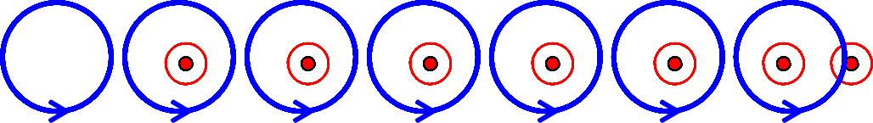
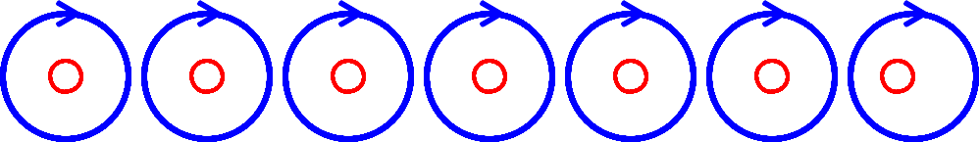
Magnetic Field due to a Solenoid:
B
x
x
x
x
x
x
x
I
I
TIP:
When we look at any end of the coil carrying current, if the current is in anti-clockwise direction then that end of coil behaves like North Pole and if the current is in clockwise direction then that end of the coil behaves like South Pole.

Slide 14
MAGNETIC EFFECT OF CURRENT - II
Lorentz Magnetic Force
Fleming’s Left Hand Rule
Force on a moving charge in uniform Electric and Magnetic fields
Force on a current carrying conductor in a uniform Magnetic Field
Force between two infinitely long parallel current-carrying conductors
Definition of ampere
Representation of fields due to parallel currents
Torque experienced by a current-carrying coil in a uniform Magnetic Field
Moving Coil Galvanometer
Conversion of Galvanometer into Ammeter and Voltmeter
Differences between Ammeter and Voltmeter

Slide 15
Lorentz Magnetic Force:
A current carrying conductor placed in a magnetic field experiences a force which means that a moving charge in a magnetic field experiences force.
F
F_{m} = q (v x B) or
F_{m} = (q v B sin θ) n
where θ is the angle between v and B Special Cases:
q ₊
θ
B
I
v
If the charge is at rest, i.e. v = 0, then F_{m} = 0. So, a stationary charge in a magnetic field does not experience any force.
If θ = 0°or 180°i.e. if the charge moves parallel
or anti-parallel to the direction of the magnetic field, then F_{m} = 0.
I
_{q} -
θ
B
v
iii) If θ = 90°i.e. if the charge moves perpendicular to the magnetic field, then the force is
F
maximum.
^{F}m (max) ^{= q v B}

Slide 16
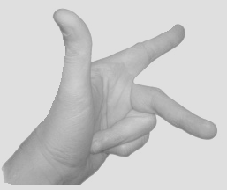
Fleming’s Left Hand Rule:
Force (F)
Magnetic Field
(B)
If the central finger, fore finger and thumb of left hand are stretched mutually perpendicular to each other and the central finger points to current, fore finger points to magnetic field, then thumb points in the direction of motion (force) on the current carrying conductor.
Electric Current (I)
TIP:
Remember the phrase ‘e m f’ to represent electric current, magnetic
field and force in anticlockwise direction of the fingers of left hand.
Force on a moving charge in uniform Electric and Magnetic Fields:
When a charge q moves with velocity v in region in which both electric field E and magnetic field B exist, then the Lorentz force is
F = qE + q (v x B) or F = q (E + v x B)

Slide 17
Force on a current-carrying conductor in a uniform Magnetic Field:
Force experienced by each electron in
the conductor is f = - e (v_{d} x B)
F
I
v_{d}
If n be the number density of electrons, A be the area of cross section of the conductor, then no. of electrons in the element dl is n A dl.
dl
θ
-
B
A I
l
Force experienced by the electrons in dl is dF = n A dl [ - e (v_{d} x B)] = - n e A v_{d} (dl X B)
= I (dl x B)
where I = neAv_{d} and -ve sign represents that the direction of dl is opposite to that of v_{d})
F = ∫ dF = ∫ I (dl x B)
F = I (l x B)
F = I l B sin θ
or

Slide 18
Forces between two parallel infinitely long current-carrying conductors:
Magnetic Field on RS due to current in PQ is
Q
S
µ₀ I₁
2π r
(in magnitude)
B₁ =
Force acting on RS due to current I₂ through it is
I₁
B₂
I₂
x B₁
µ₀ I₁
2π r
µ₀ I₁ I₂ l
2π r
^{F}12 ^{F}21
F₂₁ =
I l sin 90˚
or F₂₁ =
2
B₁ acts perpendicular and into the plane of the diagram by Right Hand Thumb Rule. So, the angle between l and B₁ is 90˚ . l is length of the conductor.
Magnetic Field on PQ due to current in RS is
r
µ₀ I₂
2π r
P
R
B₂ =
(in magnitude)
Force acting on PQ due to current I₁ through it is
µ₀ I₁ I₂ l
(The angle between l and B₂ is 90˚ and B₂ Is emerging out)
µ₀ I₂
2π r
I l sin 90˚
or
F₁₂ =
F₁₂ =
1
2π r
µ₀ I₁ I₂ l
= F =
2π r
^{F}12 ^{= F}21
µ₀ I₁ I₂
F / l =
2π r
Force per unit length of the conductor is
N / m

Slide 19
Q
S
Q
S
I₁
I₁
I₂
F F
F
F
x
x
x
r
r
I₂
P
R
P
R
By Fleming’s Left Hand Rule, the conductors experience force towards each other and hence attract each other.
By Fleming’s Left Hand Rule, the conductors experience force away from each other and hence repel each other.

Slide 20
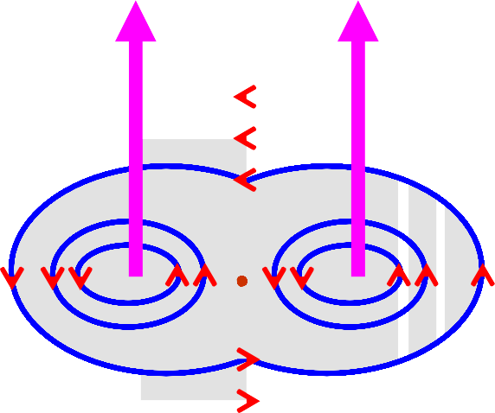
Definition of Ampere:
Force per unit length of the conductor is
µ₀ I₁ I₂
2π r
N / m
F / l =
When I₁ = I₂ = 1 Ampere and r = 1 m, then F = 2 x 10⁻⁷ N/m.
One ampere is that current which, if passed in each of two parallel conductors of infinite length and placed 1 m apart in vacuum causes each conductor to experience a force of 2 x 10⁻⁷ Newton per metre of length of the conductor.
Representation of Field due to Parallel Currents:
I₂
I₁ I₁
I₂
B
B
N

Slide 21
Torque experienced by a Current Loop (Rectangular) in a
uniform Magnetic Field:
^{F}SP
Let θ be the angle between the plane of the loop and the direction of the magnetic field. The axis of the coil is perpendicular to the magnetic field.
b
S
θ
^{F}RS
F_{SP} = I (b x B)
| F_{SP} | = I b B sin θ
F_{QR} = I (b x B)
| F_{QR} | = I b B sin θ
Forces F_{SP} and F_{QR} are equal in magnitude but opposite in direction and they cancel out each other. Moreover they act along the same line of action (axis) and hence do not produce torque.
F_{PQ} = I (l x B)
P
I
x
B
l
F
PQ
R
I
θ
Q
^{F}QR
| F_{PQ} | = I l B sin 90°= I l B F_{RS} = I (l x B)
| F_{Rs} | = I l B sin 90°= I l B
Forces F_{PQ} and F_{RS} being equal in magnitude but opposite in direction cancel out each other and do not produce any translational motion. But they act along different lines of action and hence produce torque about the axis of the coil.

Slide 22
Torque experienced by the coil is
^{F}RS
ז = F_{PQ} x PN
ז = I l B (b cos θ) ז = I lb B cos θ ז = I A B cos θ
ז = N I A B cos θ
(in magnitude)
_{x} S
b
θ
B
P
θ
Φ
N
(A = lb)
(where N is the no. of turns)
n
F
PQ
I
If Φ is the angle between the normal to the coil and the direction of the magnetic field, then
Φ + θ = 90° i.e. θ = 90° - Φ
So,
I
R
B
Q
Φ
ז = I A B cos (90° - Φ)
ז = N I A B sin Φ
n
NOTE:
One must be very careful in using the formula in terms of cos or sin since it depends on the angle taken whether with the plane of the coil or the normal of the coil.

Slide 23
Torque in Vector form:
ז = N I A B sin Φ
ז = (N I A B sin Φ) n
(where n is unit vector normal to the plane of the loop)
ז = N I (A x B)
or
ז = N (M x B)
(since M = I A is the Magnetic Dipole Moment)
Note:
The coil will rotate in the anticlockwise direction (from the top view, according to the figure) about the axis of the coil shown by the dotted line.
The torque acts in the upward direction along the dotted line (according to Maxwell’s Screw Rule).
3) If Φ = 0°, then ז = 0.
4)
5)
6)
If Φ = 90°, then ז is maximum. i.e.
ז _{max} = N I A B
Units: B in Tesla, I in Ampere, A in m² and ז in Nm.
The above formulae for torque can be used for any loop irrespective of its shape.

Slide 24
Moving Coil or Suspended Coil or D’ Arsonval Type Galvanometer:
Torque experienced by the coil is
ז = N I A B sin Φ
Restoring torque in the coil is
T
PBW
E
M
ז = k α
(where k is
^{F}RS S
restoring torque per unit angular twist, α is the angular twist in the wire)
At equilibrium,
N I A B sin Φ = k α
P
N
x
S
B
Q
R
k N A B sin Φ
^{F}PQ
I =
α
LS
Hair Spring
TS
LS
The factor sin Φ can be eliminated by choosing Radial Magnetic Field.
T – Torsion Head, TS – Terminal screw, M – Mirror, N,S – Poles pieces of a magnet, LS – Levelling Screws, PQRS – Rectangular coil, PBW – Phosphor Bronze Wire

Slide 25
Radial Magnetic Field:
The (top view PS of) plane of the coil PQRS lies along the magnetic lines of force in whichever position the coil comes to rest in equilibrium.
So, the angle between the plane of the coil and the magnetic field is 0°.
or the angle between the normal to the plane of the coil and the magnetic field is 90°.
S
N
S
P
B
Mirror
i.e. sin Φ = sin 90°= 1
Lamp
2α
k N A B
or I = G α
k
where G =
Scale
I =
α
N A B
is called Galvanometer constant
Current Sensitivity of Galvanometer:
It is the defection of galvanometer per unit current.
α
I
N A B
k
=
Voltage Sensitivity of Galvanometer:
It is the defection of galvanometer per unit voltage.
α
V
=
N A B
kR

Slide 26
Conversion of Galvanometer to Ammeter:
Galvanometer can be converted into ammeter by shunting it with a very small resistance.
Potential difference across the galvanometer and shunt resistance are equal.
I
I_{g}
G
S
I_{s} = I - I_{g}
I_{g} G
(I – I_{g} ) S = I_{g} G
or
S =
I – I_{g}
Conversion of Galvanometer to Voltmeter:
Galvanometer can be converted into voltmeter by connecting it with a very high resistance.
Potential difference across the given load resistance is the sum of p.d across galvanometer and p.d. across the high resistance.
I_{g} G R
V
V
I_{g}
- G
V = I_{g} (G + R)
or R =

Slide 27
Difference between Ammeter and Voltmeter:
S.No. | Ammeter | Voltmeter
1 | It is a low resistance instrument. | It is a high resistance instrument.
2 | Resistance is GS / (G + S) | Resistance is G + R
3 | Shunt Resistance is (GI_{g}) / (I – I_{g}) and is very small. | Series Resistance is (V / I_{g}) - G and is very high.
4 | It is always connected in series. | It is always connected in parallel.
5 | Resistance of an ideal ammeter is zero. | Resistance of an ideal voltmeter is infinity.
6 | Its resistance is less than that of the galvanometer. | Its resistance is greater than that of the voltmeter.
7 | It is not possible to decrease the range of the given ammeter. | It is possible to decrease the range of the given voltmeter.

Slide 28
MAGNETIC EFFECT OF CURRENT - III
Cyclotron
Ampere’s Circuital Law
Magnetic Field due to a Straight Solenoid
Magnetic Field due to a Toroidal Solenoid

Slide 29
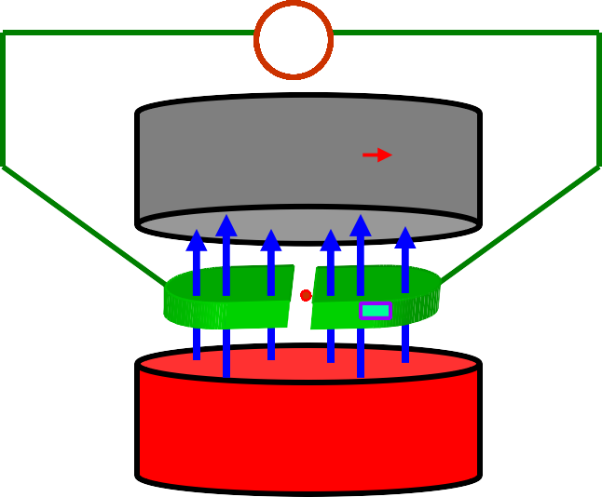
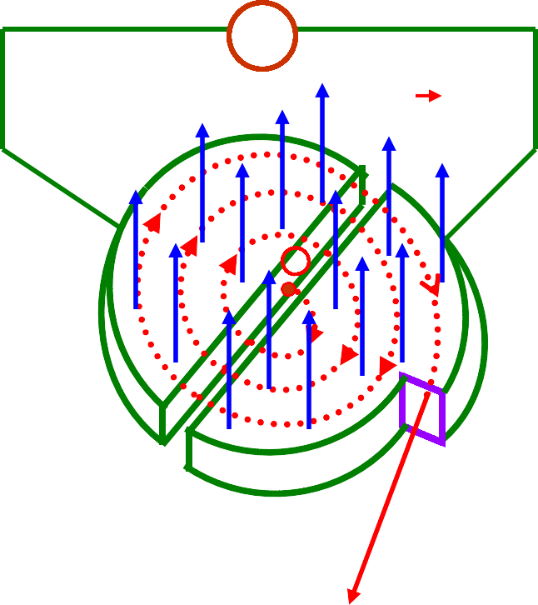
Cyclotron:
H F
Oscillator
S
B
B
D₁
D₂
+
W
D₁
D₂
N
W
D₁, D₂ – Dees
W – Window
N, S – Magnetic Pole Pieces B - Magnetic Field
Working: Imagining D₁ is positive and D₂ is negative, the + vely charged particle kept at the centre and in the gap between the dees get accelerated towards D₂. Due to perpendicular magnetic field and according to Fleming’s Left Hand Rule the charge gets deflected and describes semi-circular path.
When it is about to leave D₂, D₂ becomes + ve and D₁ becomes – ve. Therefore the particle is again accelerated into D₁ where it continues to describe the semi-circular path. The process continues till the charge traverses through the whole space in the dees and finally it comes out with very high speed through the window.

Slide 30
Theory:
The magnetic force experienced by the charge provides centripetal force required to describe circular path.
mv² / r = qvB sin 90°
(where m – mass of the charged particle, q – charge, v – velocity on the path of
radius – r, B is magnetic field and 90°is the angle b/n v and B)
v =
B q r
m
If t is the time taken by the charge to describe the semi-circular path inside the dee, then
Time taken inside the dee depends only on
π r
π m B q
t =
or t =
the magnetic field and m/q ratio and not on the speed of the charge or the radius of the path.
v
If T is the time period of the high frequency oscillator, then for resonance,
T = 2 t or
2πm
T =
B q
If f is the frequency of the high frequency oscillator (Cyclotron Frequency), then
B q
f =
2πm

Slide 31
Maximum Energy of the Particle:
Kinetic Energy of the charged particle is
2 2 2
K.E. = ½ m v² = ½ m ( ^{B q r} )²
B q r
= ½
m m
Maximum Kinetic Energy of the charged particle is when r = R (radius of the D’s).
_{B}2 _{q}2 _{R}2
K.E. _{max} = ½ _{m}
The expressions for Time period and Cyclotron frequency only when m remains constant. (Other quantities are already constant.)
But m varies with v according to Einstein’s Relativistic Principle as per
m₀
m =
[1 – (v² / c²)]^{½}
If frequency is varied in synchronisation with the variation of mass of the charged particle (by maintaining B as constant) to have resonance, then the cyclotron is called synchro – cyclotron.
If magnetic field is varied in synchronisation with the variation of mass of the charged particle (by maintaining f as constant) to have resonance, then the cyclotron is called isochronous – cyclotron.
NOTE: Cyclotron can not be used for accelerating neutral particles. Electrons can not be accelerated because they gain speed very quickly due to their lighter mass and go out of phase with alternating e.m.f. and get lost within the dees.

Slide 32
Ampere’s Circuital Law:
The line integral ∫ B . dl for a closed curve is equal to µ₀ times the net current I threading through the area bounded by the curve.
I
B
∫ B . dl = µ₀ I
dl
B
r
I
O
Proof:
Current is emerging out and the magnetic field is anticlockwise.
∫ B . dl =
∫ B . dl cos 0°
= ∫ B . dl = B
∫ dl
= B (2π r)
= ( µ₀ I / 2π r) x 2π r
∫ B . dl = µ₀ I

Slide 33
Magnetic Field at the centre of a Straight Solenoid:
a
S R
B
P
a
Q
x
x
x
x
x
x
x
I
I
∫ B . dl = µ₀ I₀
(where I is the net current
0
threading through the solenoid)
∫ B . dl = ∫ B . dl +
∫ B . dl + ∫ B . dl +
∫ B . dl
SP
∫ 0 . dl cos 0° +
PQ QR
RS
∫ B . dl cos 90° +
= ∫ B . dl cos 0° +
= B ∫ dl = B.a
∫ B . dl cos 90°
and µ₀ I₀ = µ₀ n a I
B = µ₀ n I
(where n is no. of turns per unit length, a is the length of the path and I is the current passing through the lead of the solenoid)

Slide 34
Magnetic Field due to Toroidal Solenoid (Toroid):
∫ B . dl = µ₀ I₀
dl
P
B ≠ 0
B
∫ B . dl =
∫ B . dl cos 0°
= B ∫ dl = B (2π r) And µ₀ I₀ = µ₀ n (2π r) I
r
B = 0 Q
O B = 0
B = µ₀ n I
NOTE:
The magnetic field exists only in the tubular area bound by the coil and it does not exist in the area inside and outside the toroid.
i.e. B is zero at O and Q and non-zero at P.
I

